Slide 1
Gnana Charishma J
Final Project

Slide 2
PROJECT TITLE
IMAGE GENERATION USING GAN

Slide 3
AGENDA
Problem statement
Project Overview
Who are the end users?
Your solution and its value proposition
The Wow in your solution
Modelling
Results
Conclusion

Slide 4

PROBLEM STATEMENT
Manual creation of large image datasets is time-consuming and costly.
Existing image generation methods lack diversity and realism.
Ethical concerns surrounding the use of AI-generated images.

Slide 5
PROJECT OVERVIEW
GAN Architecture:
Generator network creates synthetic images.
Discriminator network distinguishes between real and generated images.
Training Process:
Adversarial training where generator and discriminator compete.
Evaluation:
Assessing generated images for realism and diversity.

Slide 6
EXPECTED OUTCOME:
Efficient generation of realistic images.
Exploration of diverse applications across domains.
Responsible use of AI technologies in image generation.

Slide 7
WHO ARE THE END USERS?
Artists and Designers:
Media and Entertainment Industry:
Researchers and Academia:.
Businesses and Marketing Agencies:
Medical and Scientific Communities:
General Public:

Slide 8

YOUR SOLUTION AND ITS VALUE PROPOSITION
Creative Empowerment: Enabling new avenues of expression.
Cost Efficiency: Reduced time and resources for image creation.
Data Augmentation: Enhancing ML model performance.
Innovation Catalyst: Driving innovation in various industries.
Competitive Advantage: Offering cutting-edge, customizable image solutions.

Slide 9
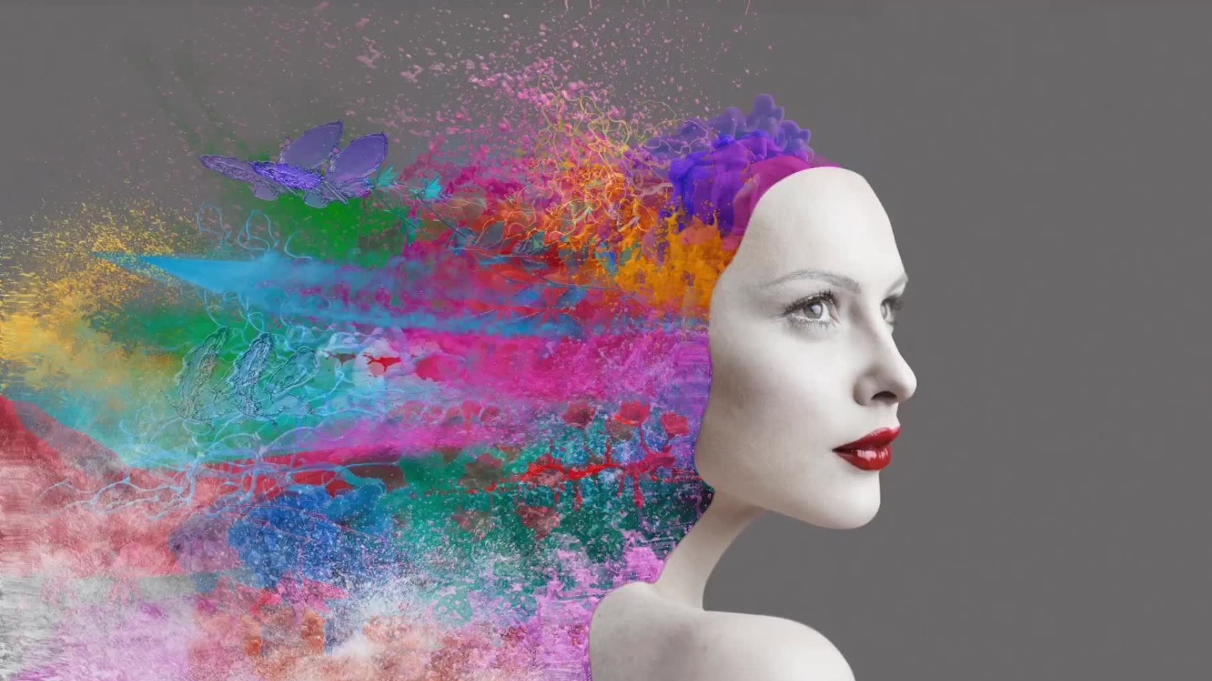
THE WOW IN YOUR SOLUTION
Stunning Creations:
Showcase mesmerizing images generated by our GAN model.
Demonstrate the lifelike quality and diversity of generated images.
Limitless Potential:
Explore the endless possibilities for creative expression enabled by GANs.
Inspire with the idea of pushing the boundaries of imagination.
User-Friendly Experience:
Highlight the simplicity of integrating and using our GAN model.
Emphasize user-friendliness for seamless adoption.
Industry Impact:
Illustrate how our solution is reshaping industries with its transformative capabilities.
Convey the competitive advantage gained by leveraging GAN-powered image generation.

Slide 10
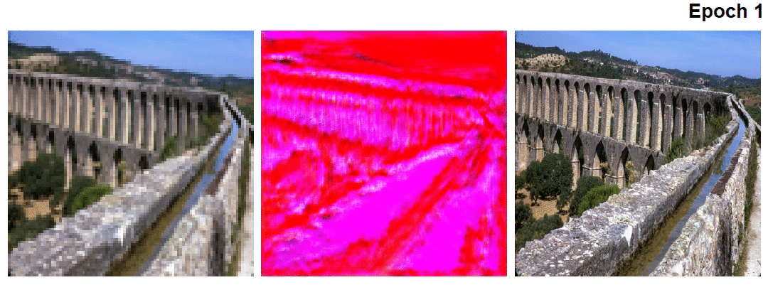
MODELLING
Image generation using Super Resolution GAN architecture

Slide 11
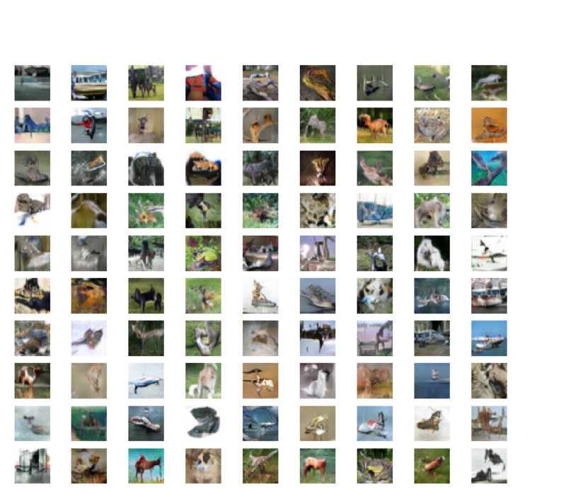
Generate your own dataset using GAN

Slide 12
RESULTS
Image Quality
This can be evaluated subjectively by human observers or objectively using metrics like Structural Similarity Index (SSIM) or Fréchet Inception Distance (FID).
Training Convergence
Monitoring the convergence of the generator and discriminator losses throughout the training process can indicate the stability and progress of the GAN model.
Diversity
GANs should be able to produce diverse images that cover a wide range of styles and variations within the given dataset. Diversity can be assessed by examining the variety of images generated.

Slide 13
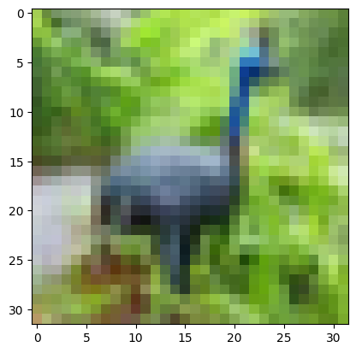
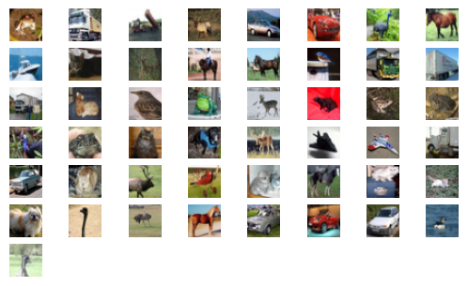

Slide 14

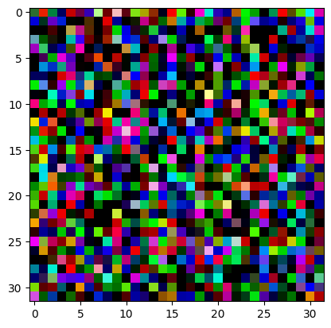

Slide 15
CONCLUSION
In conclusion, the image generation project utilizing GANs has demonstrated promising results. Our model has shown the ability to produce high-quality, diverse, and realistic images, reflecting significant progress in the field. Moving forward, continued refinement and exploration of GAN architectures and training techniques hold the potential to further enhance the capabilities of image generation systems, opening new avenues for creative expression and practical applications.

